Slide 1
Memory-Efficient Object Detection Using Ultrasonic Rangefinders On The DE2Bot
Sushanth Penta
Eric Rafalovsky
Antony Samuel
Leo Weng
Digital Design Laboratory - ECE 2031 L01
Georgia Institute of Technology
11/29/2016

Slide 2
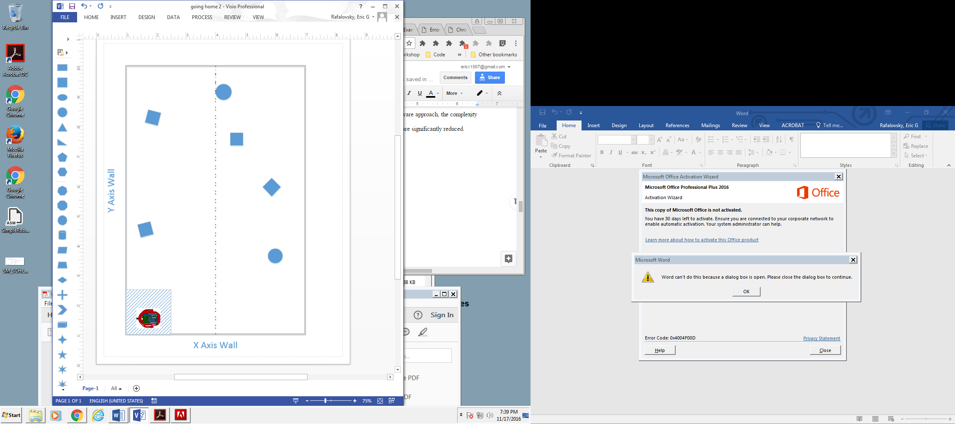
Project Description
Sample Arena Layout
Utilize the DE2Bot to autonomously locate up to 6 objects in an arena
“Tag” these objects within a 120 second timeframe
Return to a 2 by 2 foot home square after tagging each object
12 feet
8 feet

Slide 3
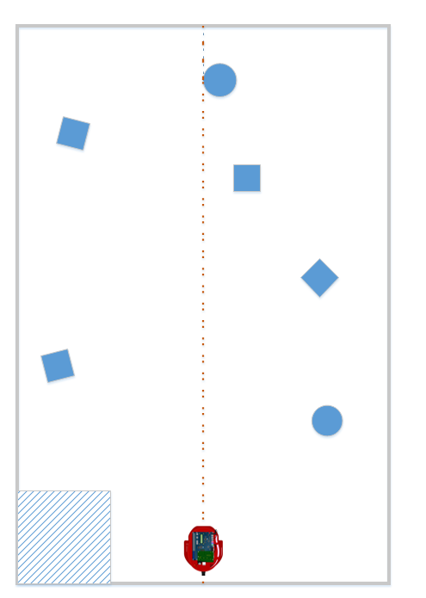
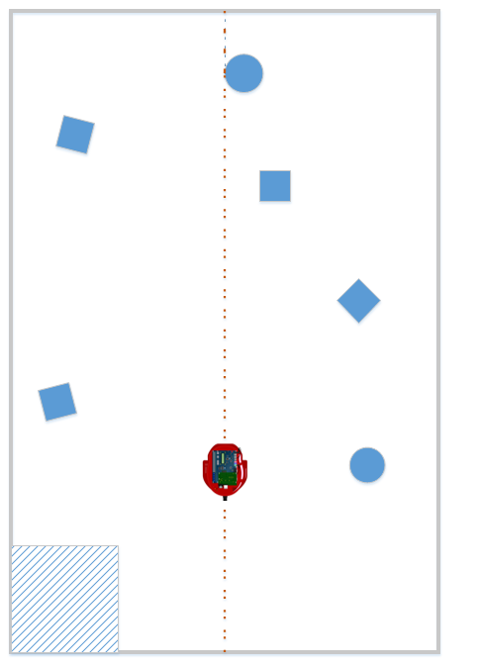
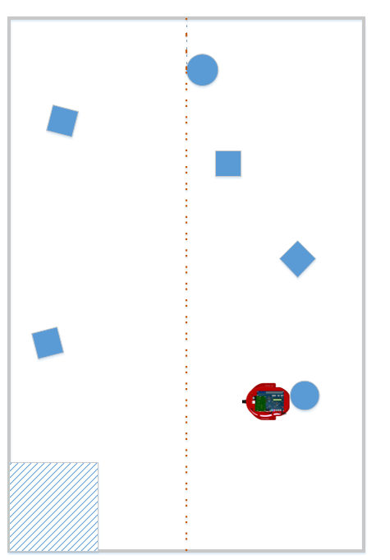
Design Overview
Reset Position
Begin Search Process
Object Detected
Tag Object

Slide 4
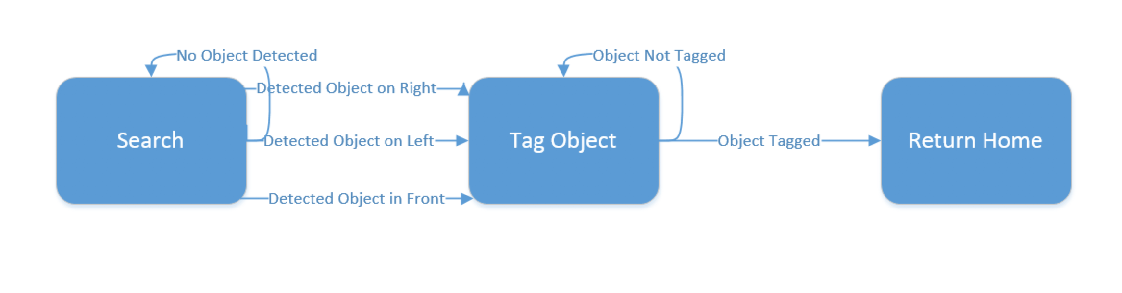
Design Implementation
Implemented through SCOMP assembly software
Primary Subroutines

Slide 5
Detecting Objects
Sonars at ± 90° and ± 12°, updating at 6.25 Hz, used for object detection
Checking left, right and directly in front of robot
Splitting the arena in two minimizes threshold distance, minimizing error due to the conical shape of sonars
3.5 foot detection threshold for ± 90° sonars

Slide 6
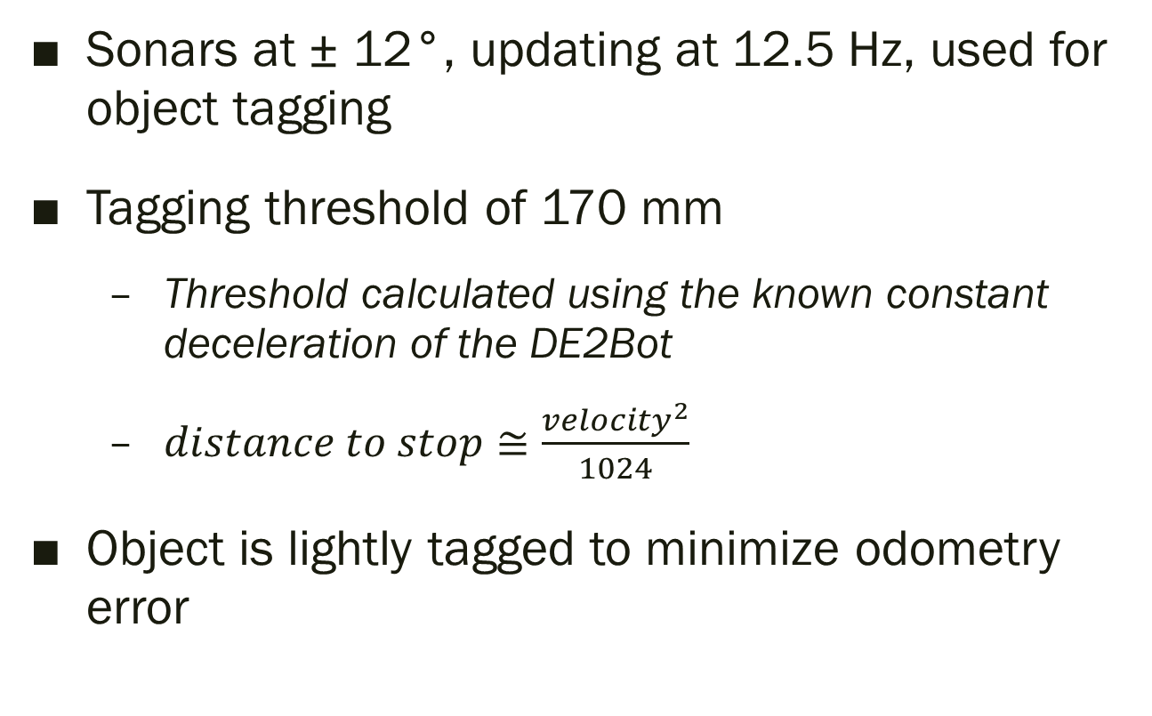
Tagging Objects
Sonars at ± 12°, updating at 12.5 Hz, used for object tagging
Tagging threshold of 170 mm
Threshold calculated using the known constant deceleration of the DE2Bot
$distance to stop≅\frac{{velocity}^{2}}{1024}$
Object is lightly tagged to minimize odometry error

Slide 7
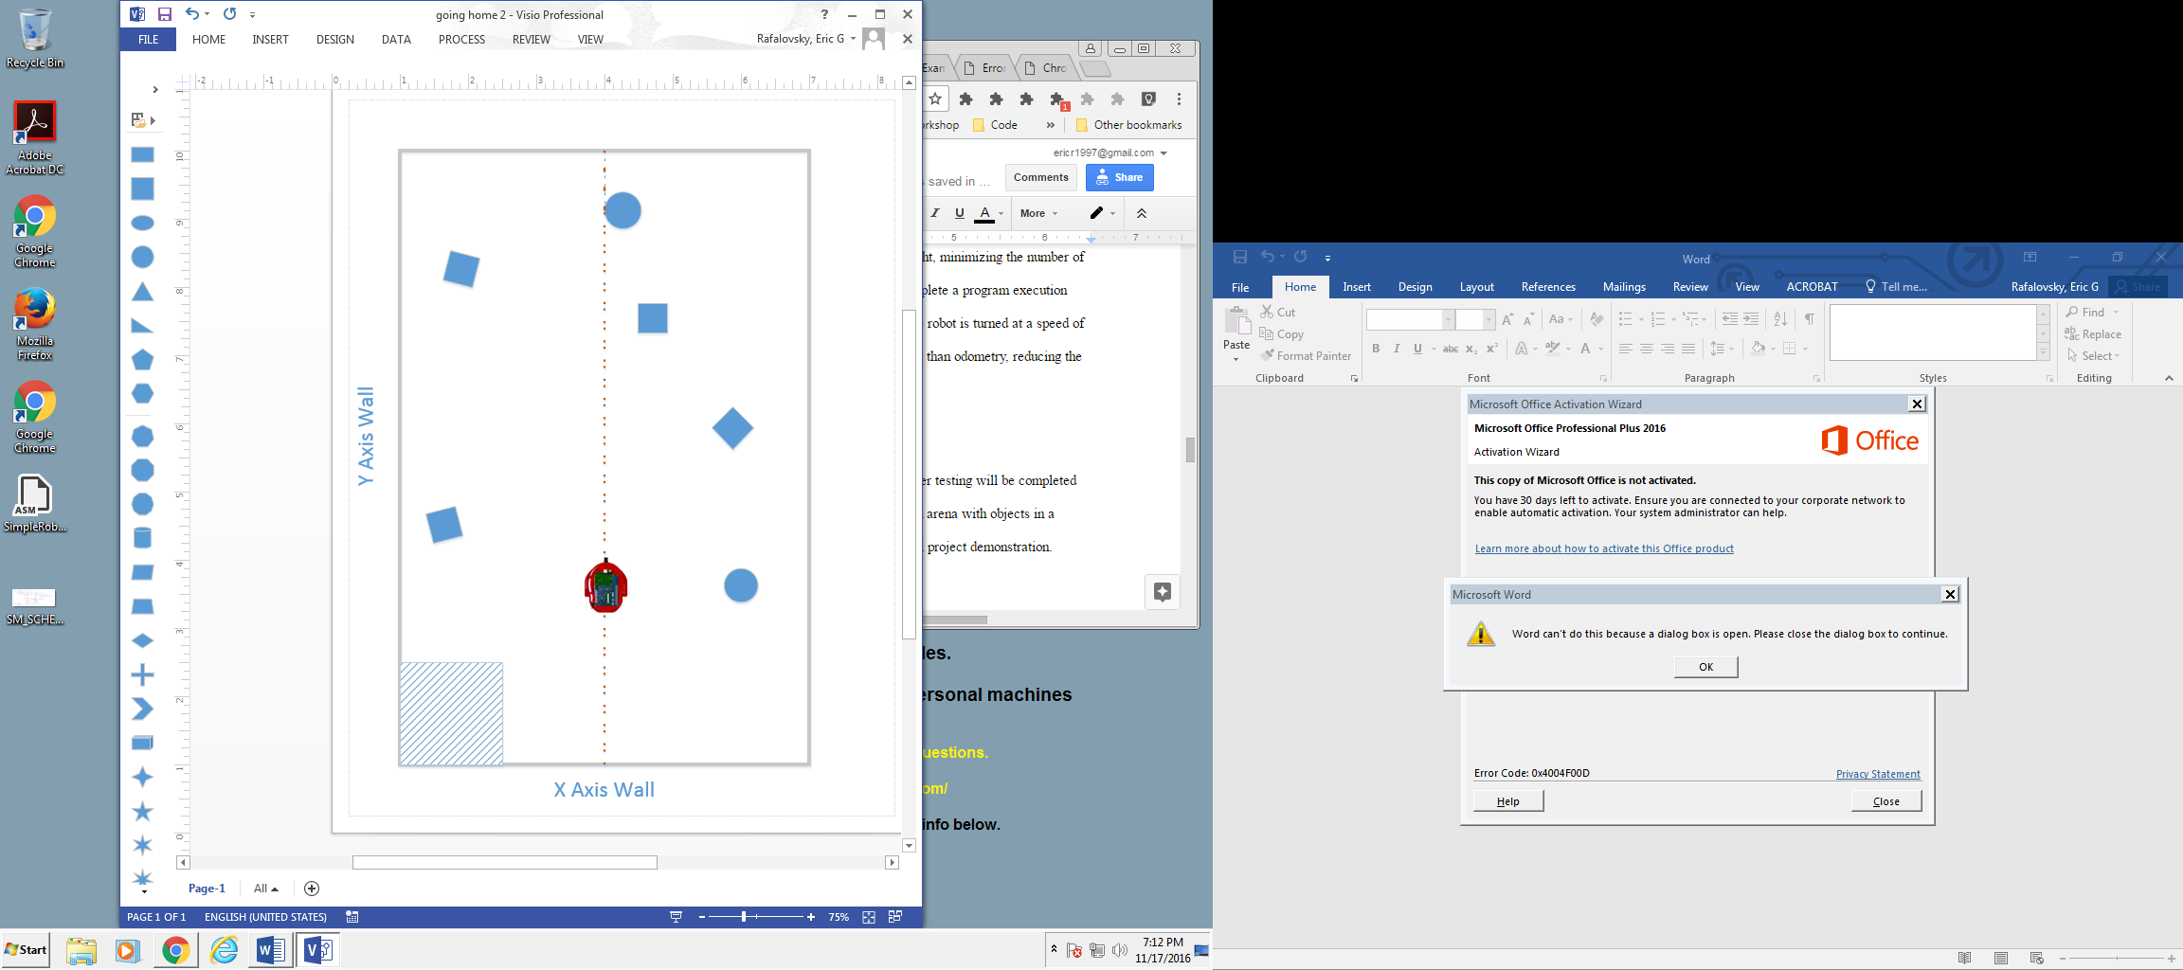
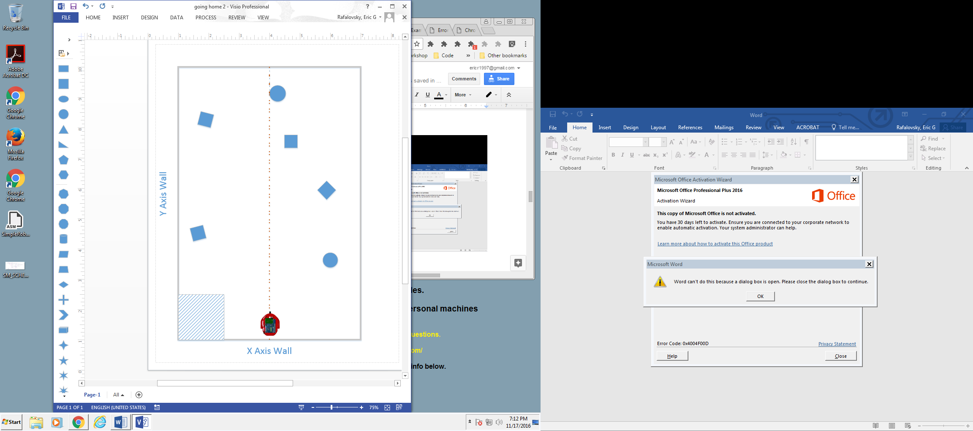

Returning Home
Odometry used to reverse robot actions
Traveled path is free from obstruction so the robot can return home at high speed

Slide 8
Achieving Multiple Robot Runs
Robot manually repositioned in home square after it returns
Odometry module reset through button press
Mechanism of delaying the robot while human is in the arena

Slide 9
Minimizing Odometry Error
DE2Bot only travels straight (parallel to either of the arena walls)
DE2Bot only makes 90° turns
DE2Bot avoids pushing arena objects
Odometry is reset before each run
Odometry is only used to return home following object tagging
Able to return to home square without wall collision >70% time

Slide 10
Challenges Encountered
Tagging objects without pushing them
Tag the object lightly by beginning to decelerate at a calculated distance
Turning the robot 90° accurately and precisely
Combinations of wheel speeds and timings were tested for the most accurate result

Slide 11
Results
Implemented in only 303 words. 15% of the default SCOMP memory
Demonstration Results
 | Run 1 | Run 2 | Average
Objects Tagged | 4 | 0 | 2
Returned Home | 0 | 0 | 0
Collisions/Pickups | 5 | 0 | 2.5

Slide 12
Design Strengths and Weakness
Strengths
Weaknesses
Robot is able to return home at high speed due to known empty path
Average distance from sonar to detected objects is minimized
Little reliance on odometry during detection
Low memory requirements due to lack of mapping
Non-direct path to tagging objects
Non-direct path back to the home square
Up to 38% less efficient than direct path

Slide 13
Future Work
Implement basic mapping of the arena to allow for:
More direct object tagging
More direct return home

